Slide 1


Institute of Industrial Automation
and Software Engineering
Deep Learning-based Monitoring of Urban Traffic using MOBATSim
Presented by: Nikita Jhawar
Supervised by: Sheng Ding
Examined by: Jun.-Prof. Dr.-Ing. Andrey Morozov

Slide 2




THESIS WORKFLOW
1
2
3
4
Adapting MOBATSim Model and Fault Injection
Result &
Comparison between DL models & Ensemble
Faulty and Fault Free Data Collection
Training DL Models for Fault Classification

Slide 3

TABLE OF CONTENTS
MOTIVATION
FAULT DETECTION
USING DL MODELS
Introduction &
FAULT INJECTION
ReSults &
Comparison
DATA COLLECTION
CONCLUSION &
FUTURE SCOPE

Slide 4
MOTIVATION

Slide 5
The automotive sector needs new tools and techniques to assess and analyze the safety of the vehicles as well as the traffic.
MOBATSim allows simulation-based
fault injection in order to evaluate
the safety of autonomous driving
systems [1].
Automated Traffic system helps in
optimizing transport system and
make it safer.
Deep Learning-based anomaly
detection in Cyber-Physical
Systems have proved to be very
effective [2].

Slide 6
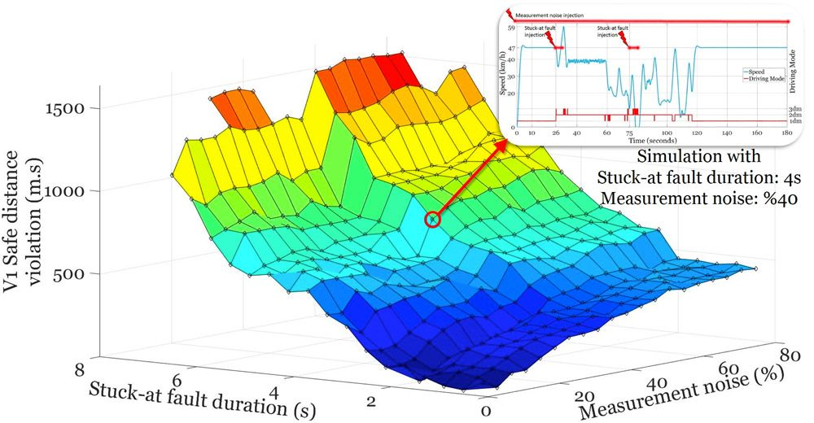
The use of MOBATSim for fault error failure chain analysis has been presented using an illustrative case study showing the effects of fault on the overall traffic safety in MOBATSim [3] by injecting fault in one vehicle in the traffic model.
Related Work
.
Safe distance violation as a function of stuck-at-fault duration and sensor noise[3].

Slide 7
INTRODUCTION & FAULT INJECTION

Slide 8
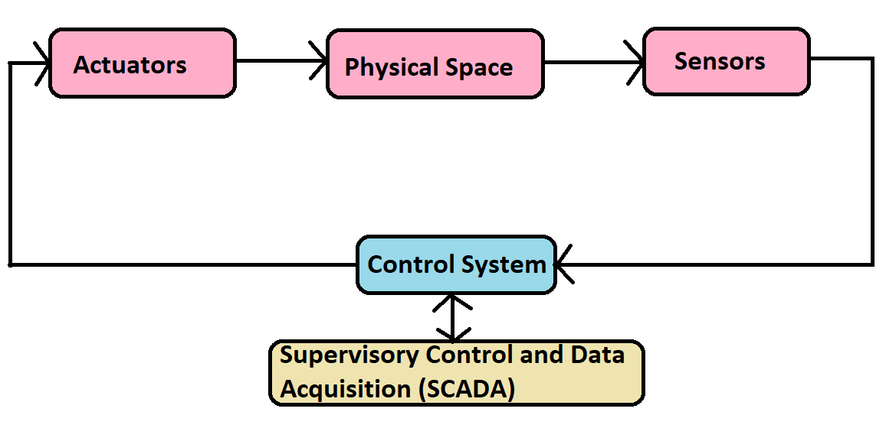
Cyber-Physical System
Cyber physical systems (CPS) is defined as systems of collaborating computational entities that are in thorough connection with the neighboring physical world as well as its ongoing processes, thus enabling data processing services [4].
MOBATSim is a type of CPS, allowing the user to develop automated driving algorithms
Generic CPS Diagram [4]

Slide 9



MOBATSim: Model-based Autonomous Traffic Simulation Framework
FI block is used to inject fault in 2 vehicles at speed and distance sensor
Three types of sensor faults are injected namely Noise, StuckAt and Offset
.The MOBATSim traffic Model has 10 vehicles sharing their speed, rotation, and translation data after simulation
Simulation is run for 3 different driving scenarios with different fault values
Two types of data i.e., Univariate and Multivariate data is collected

Slide 10
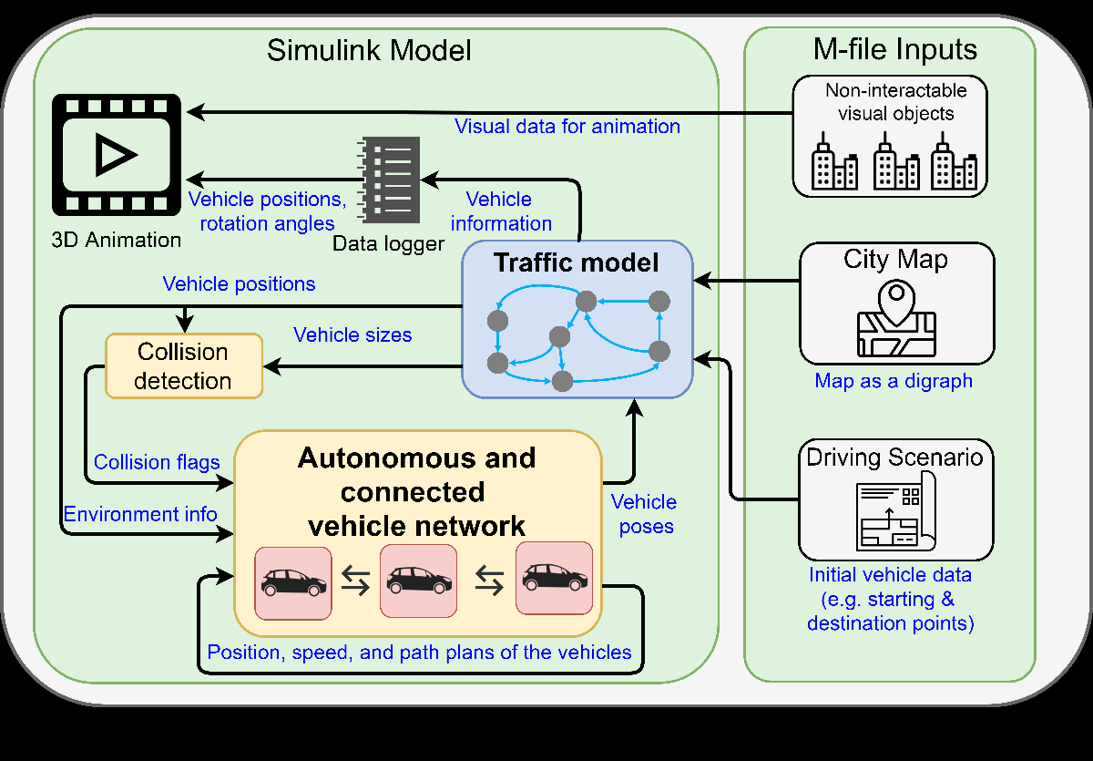
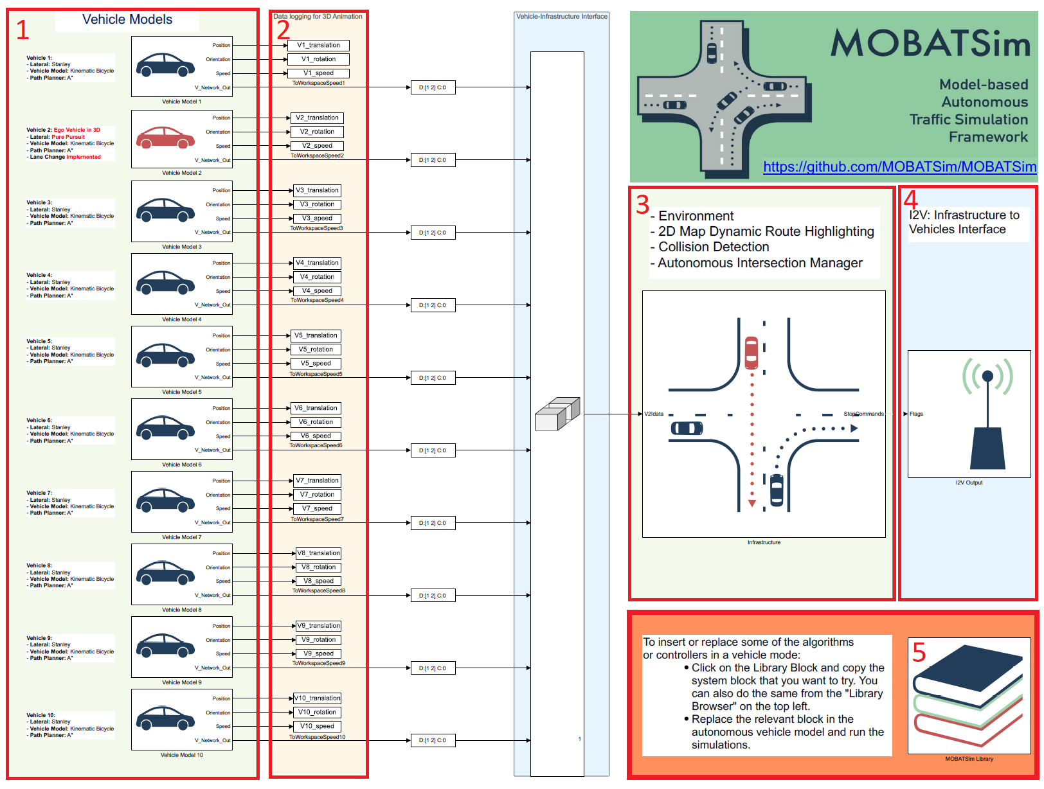
Description Of Simulink Model
Workflow Diagram [1]
Main Simulink Model [1]

Slide 11
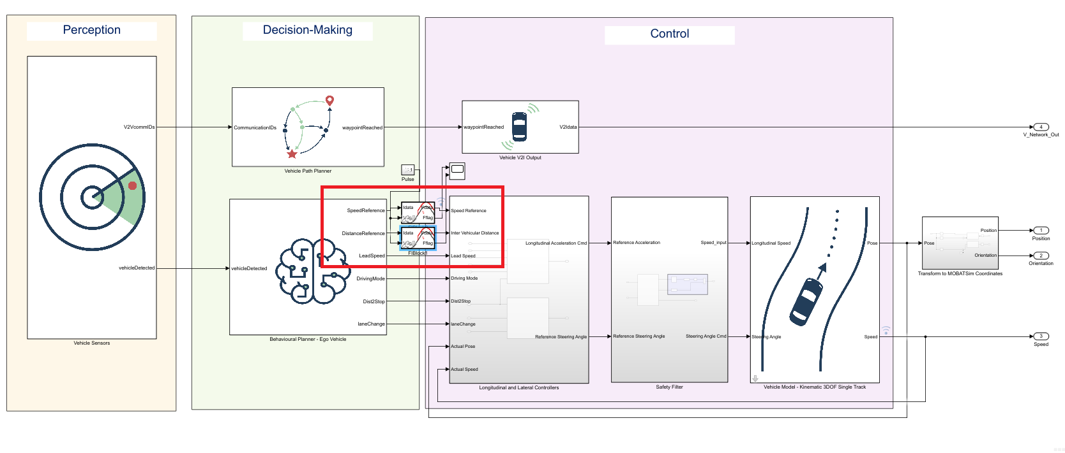
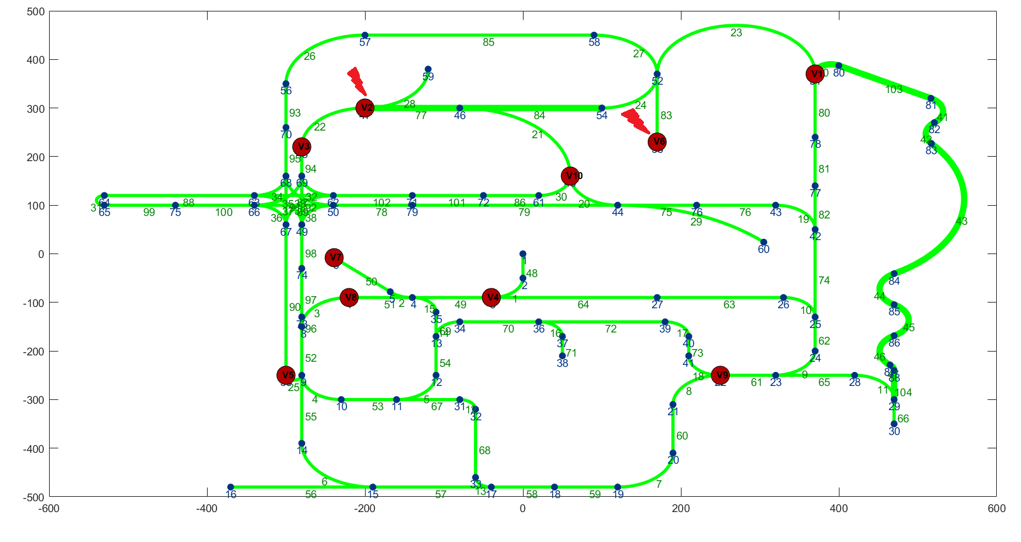
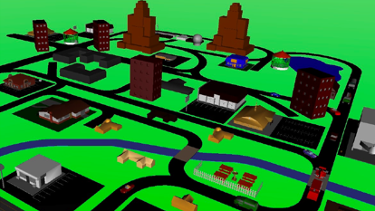
Vehicle Model After Fault Injection
2D and 3D map plot[1]
Vehicle Model after Fault Injection[1]

Slide 12
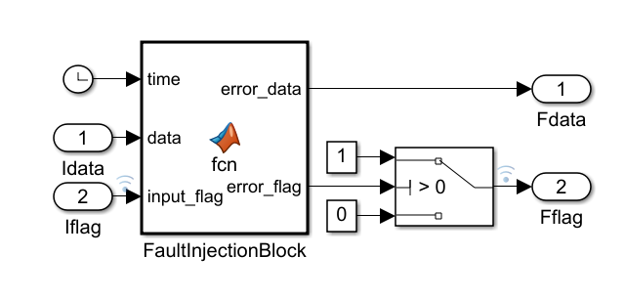
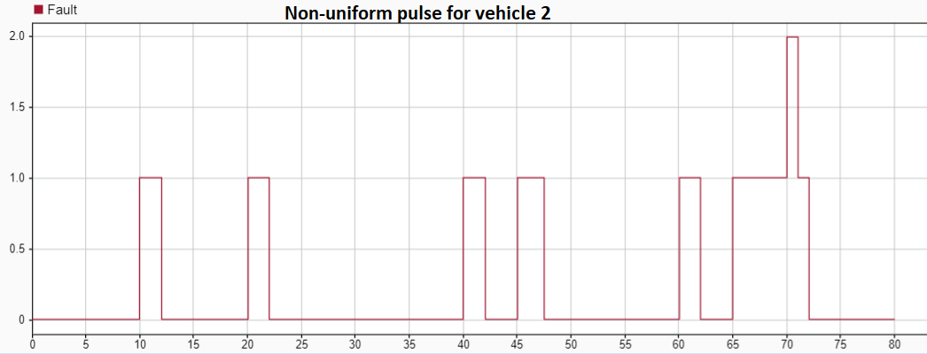
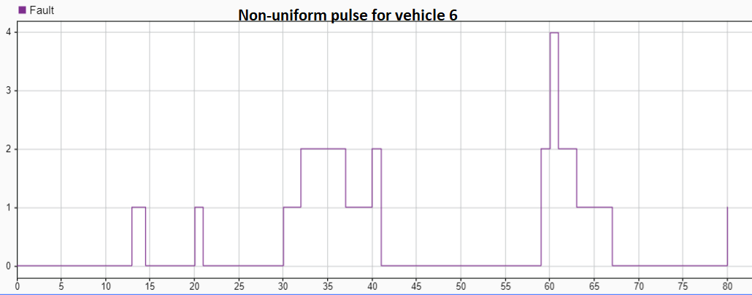
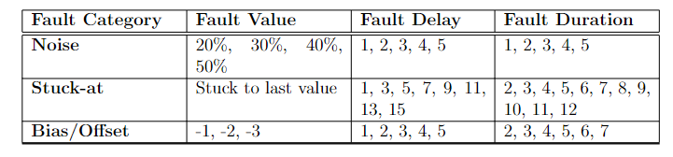
FI Block and Non-uniform Pulse Generator
FI Block[11]

Slide 13
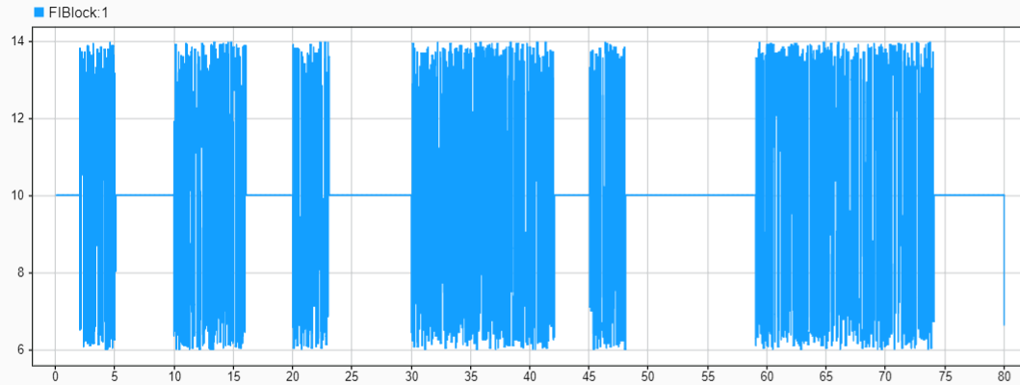
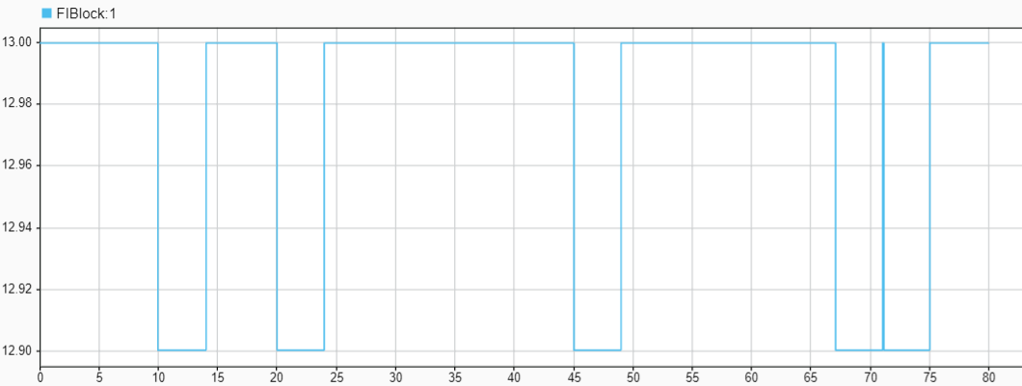
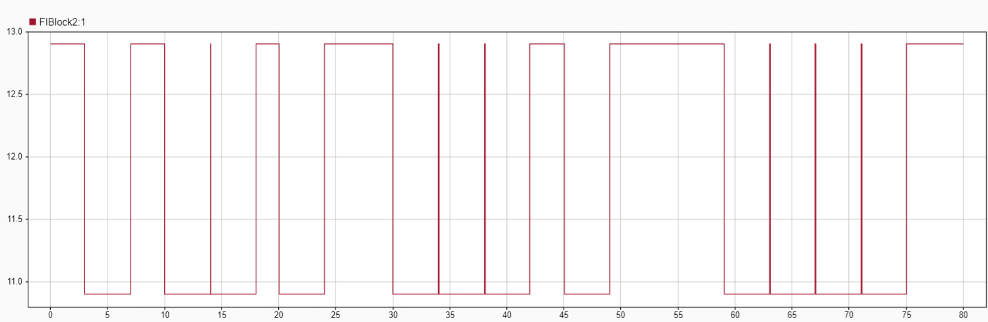
Three Categories of Fault
Noise Fault : Sampling Rate 0.02sec
Stuck-at Fault : Sampling Rate 0.02sec
Offset Fault : Sampling Rate 0.02sec

Slide 14
DATA COLLECTION

Slide 15
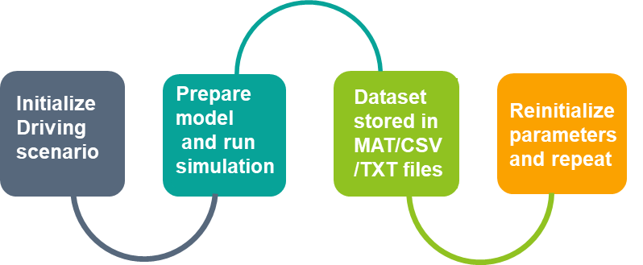
Fault-Free Data Collection
The process is repeated for three driving scenarios:
Platoon Control
Road Merge Collision
Urban City Traffic
The duration of the simulation is 80 seconds, and the data is re-sampled from 0.005 seconds to 0.02 seconds for data compression. Therefore, each data set generated for one simulation of 80 secs has 3999 data points (entries/rows)

Slide 16
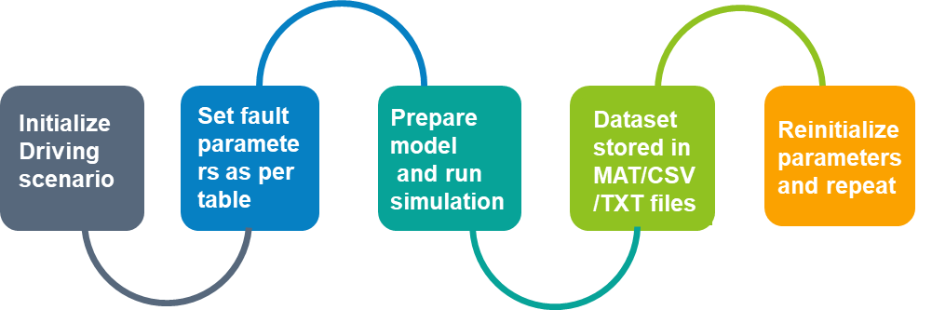
Faulty Data Collection
Data is collected for random fault delays and fault duration chosen from the table in previous slides for Noise, Stuck-at, and Offset/Bias for both vehicle 2 and vehicle 6 for all three scenarios.
Data is generated for each univariate and multivariate data. Around more than 150 faulty data files are collected with each data set generated for one simulation of 80 secs having 3999 data points

Slide 17
CSV Data Format
Time | Speed | Label
0 to 80 seconds | 0 to maximum Speed (Dependent on the scenario) | 0,1,2 or 3
Time interval of 0.02 secs | Maximum speed defined in simulation files | Depending on fault category
Dimension of Final Dataset: 287928 rows × (3 or 6) columns
72 Datasets combined having 3999 samples each
Anomaly Percentage:
Fault Free: 53.8%
Noise: 17.5%
Stuck-At: 13.75%
Offset: 14.7%
Univariate Data
Time | Speed | Rotation | Position | Translation | Label
0 to 80 seconds | 0 to maximum Speed (Dependent on the scenario) | -3 to 3 | -400 to 400 | -500 to 300 | 0,1,2 or 3
Time Interval of 0.02 seconds | Maximum speed defined in simulation files | Values pre-defined | Values pre-defined | Values pre-defined | Depending on fault category
Multivariate Data

Slide 18
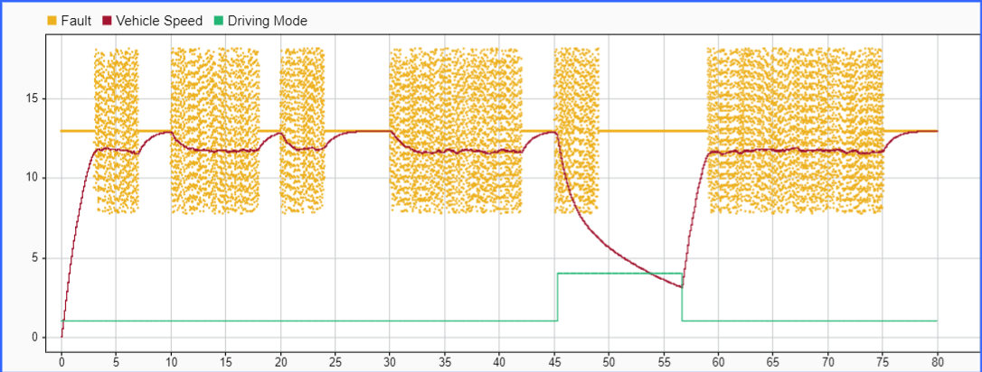
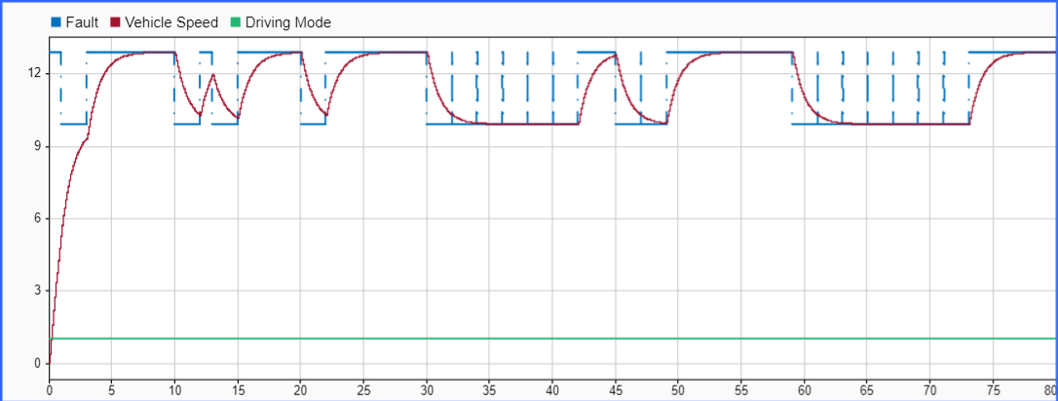
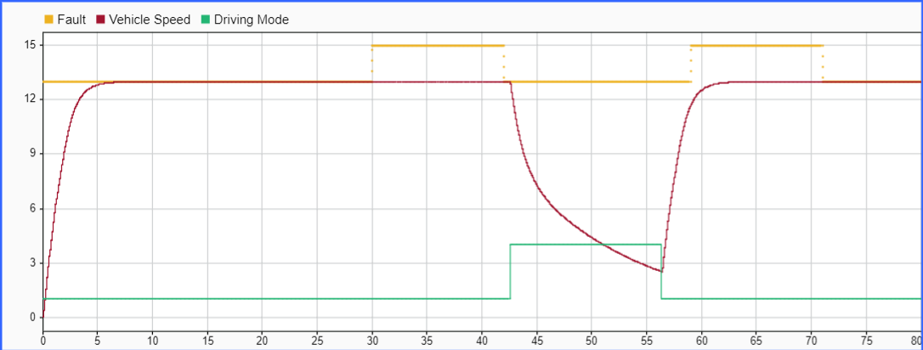
Sample Faulty Data for Vehicle 2
Noise fault injection
Offset fault injection
Stuck-At fault injection

Slide 19
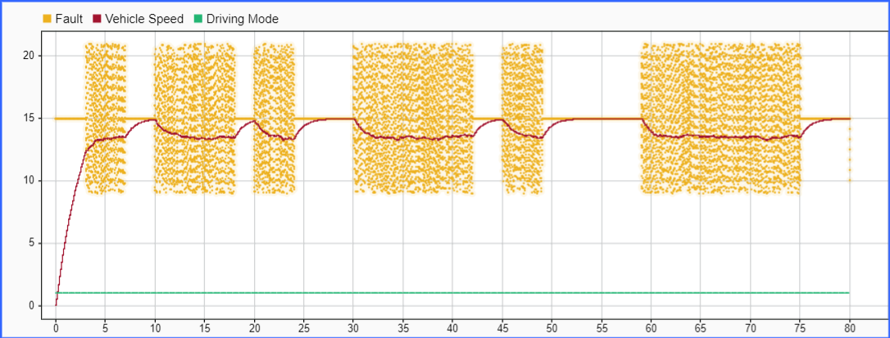
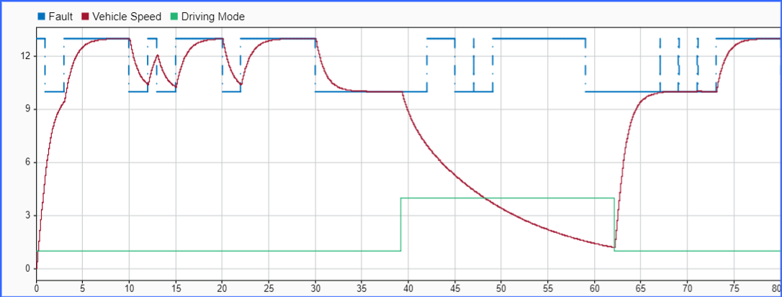
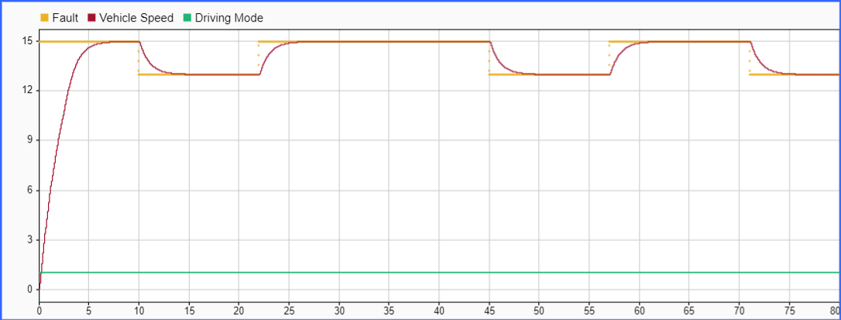
Sample Faulty Data for Vehicle 6
Noise fault injection
Offset fault injection
StuckAt fault injection

Slide 20
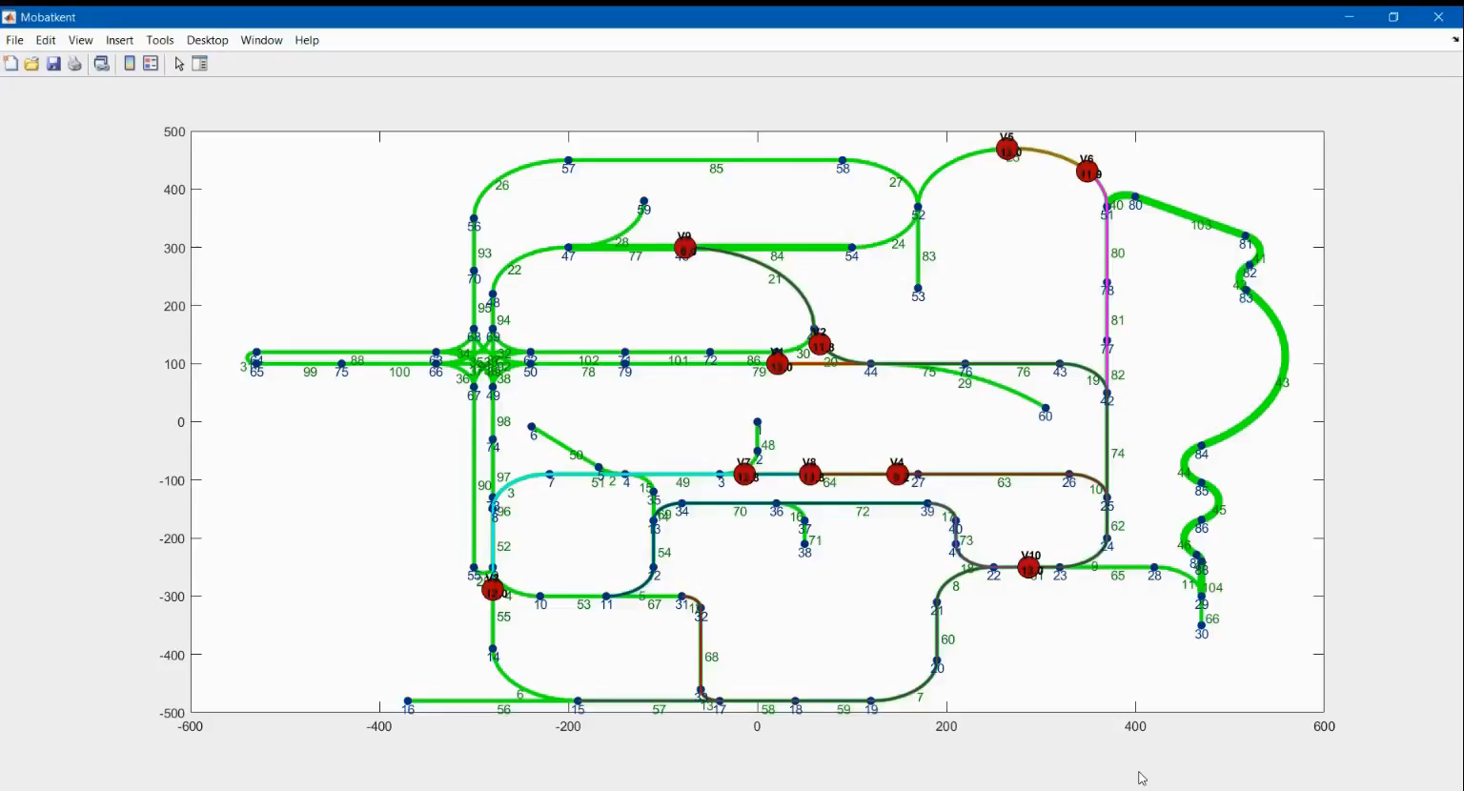
Demonstration Video

Slide 21
FAULT DETECTION USING DL MODELS

Slide 22




Steps for Data Pre-Processing
2
4
1
3
Data Shuffling
Categorical Conversion
Train-Test Data Split
Ground Truth Labeling
Conversion of class vector to the binary class matrix in order to use with categorical cross-entropy
In order to build a better DL model, we shuffle the data set for our further use
The data is then split randomly with 0.33 part being test data and 0.67 being the train data
0 denote fault-free scenario, 1 for noise fault, 2 for stuck-at and 3 for offset

Slide 23
Deep Learning Models Implemented
Recurrent Neural Network [5] consists of three types i.e., Simple RNN, Gated Recurrent Unit (GRU) and Long Short-Term Memory(LSTM)
Autoencoder is a type of neural network that is referred to learn a compressed representation of raw data as it is composed of an encoder and a decoder sub-models
Transformer models apply an evolving set of mathematical techniques, called attention or self-attention, to detect subtle ways even distant data elements in a series influence and depend on each other
In this thesis, we train and test our data with 6 different DL models i.e., Simple RNN, GRU-Simple RNN, BiGRU-BiSimple RNN [6], Autoencoders [9], Transformers [8], and hybrid LSTM-Autoencoders [7]
The three main classes of ensemble learning methods are bagging, stacking, and boosting and In the end, the Stacking Ensemble Algorithm [10] is used which involves taking the outputs of sub-models as input and attempts to learn how to best combine the input predictions to make a better output prediction.

Slide 24
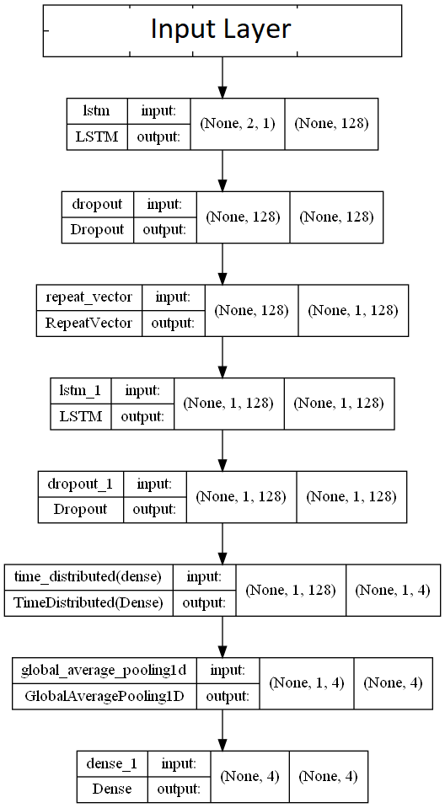
LSTM-Autoencoder Architecture
Hyper-Parameters | Value
Optimizer | Adam Optimizer
Learning Rate | 0.001
Type | Sequential
Loss | Categorical Crossentropy
Batch Size | 2048
No. of Epochs | 50
Trainable Params | 198,680
Computational Training Time (Univariate) | 21 seconds /epoch
Computational Training Time (Multivariate) | 36 seconds /epoch

Slide 25
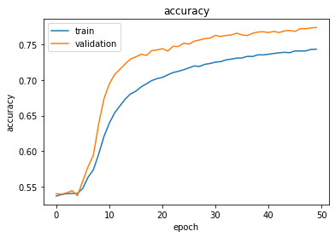
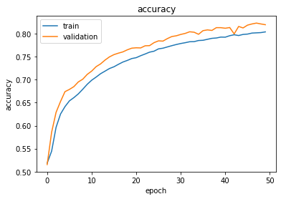
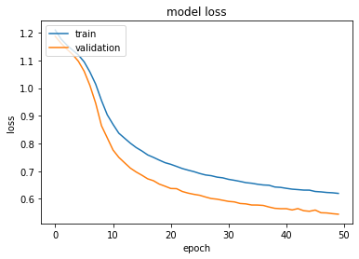
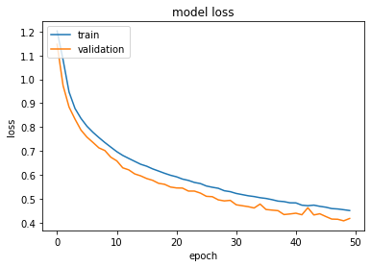
LSTM-Autoencoder Performance
Accuracy and Loss for Uni-variate Data
Accuracy and Loss for Multivariate Data

Slide 26
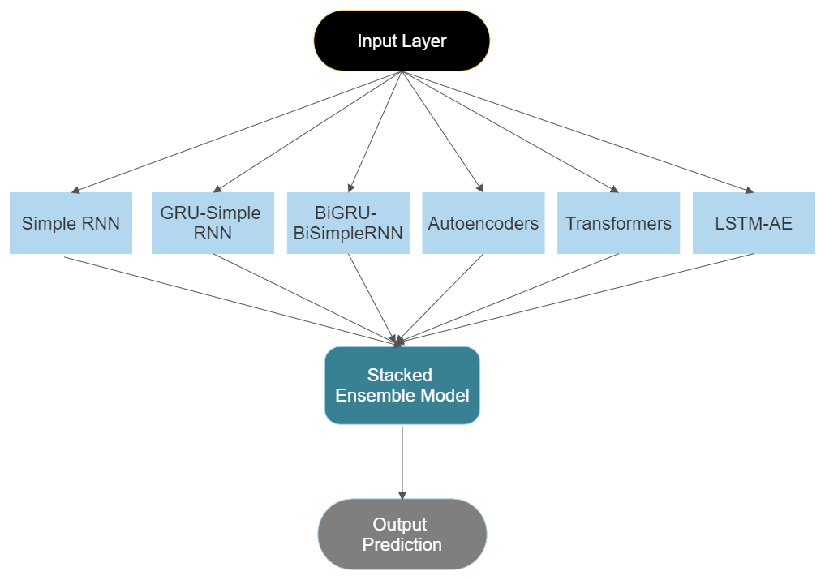
Stacking Ensemble Algorithm
Stacking procedure consists of two levels:
Level 0: The level 0 data is the training dataset inputs and level 0 models learn to make predictions from this data.
Level 1: The level 1 data takes the output of the level 0 models as input and the single level 1 model, or meta-learner, learns to make predictions from this data
A stacked generalization ensemble can use the set of predictions as a context and conditionally decide to weigh the input predictions differently, potentially resulting in better performance

Slide 27
RESULTS

Slide 28
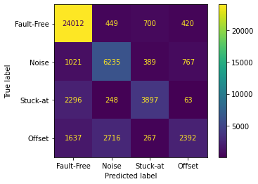
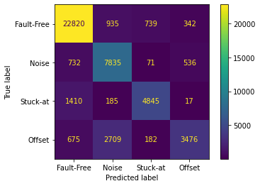
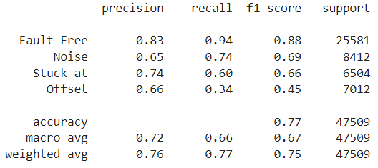
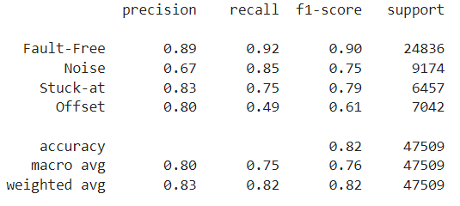
Fault Classification of LSTM-Autoencoders on Test Data
Univariate Data
Multivariate Data

Slide 29
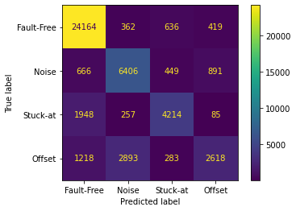
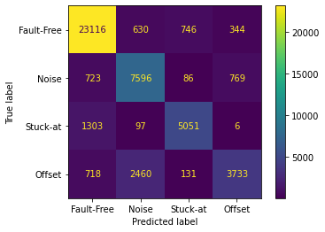
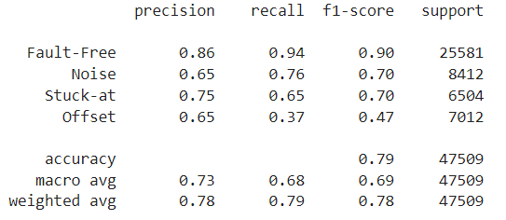
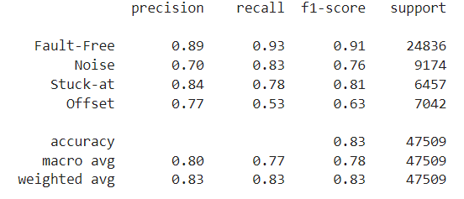
Fault Classification of Stacked Ensemble Algorithm
Univariate Data
Multivariate Data

Slide 30
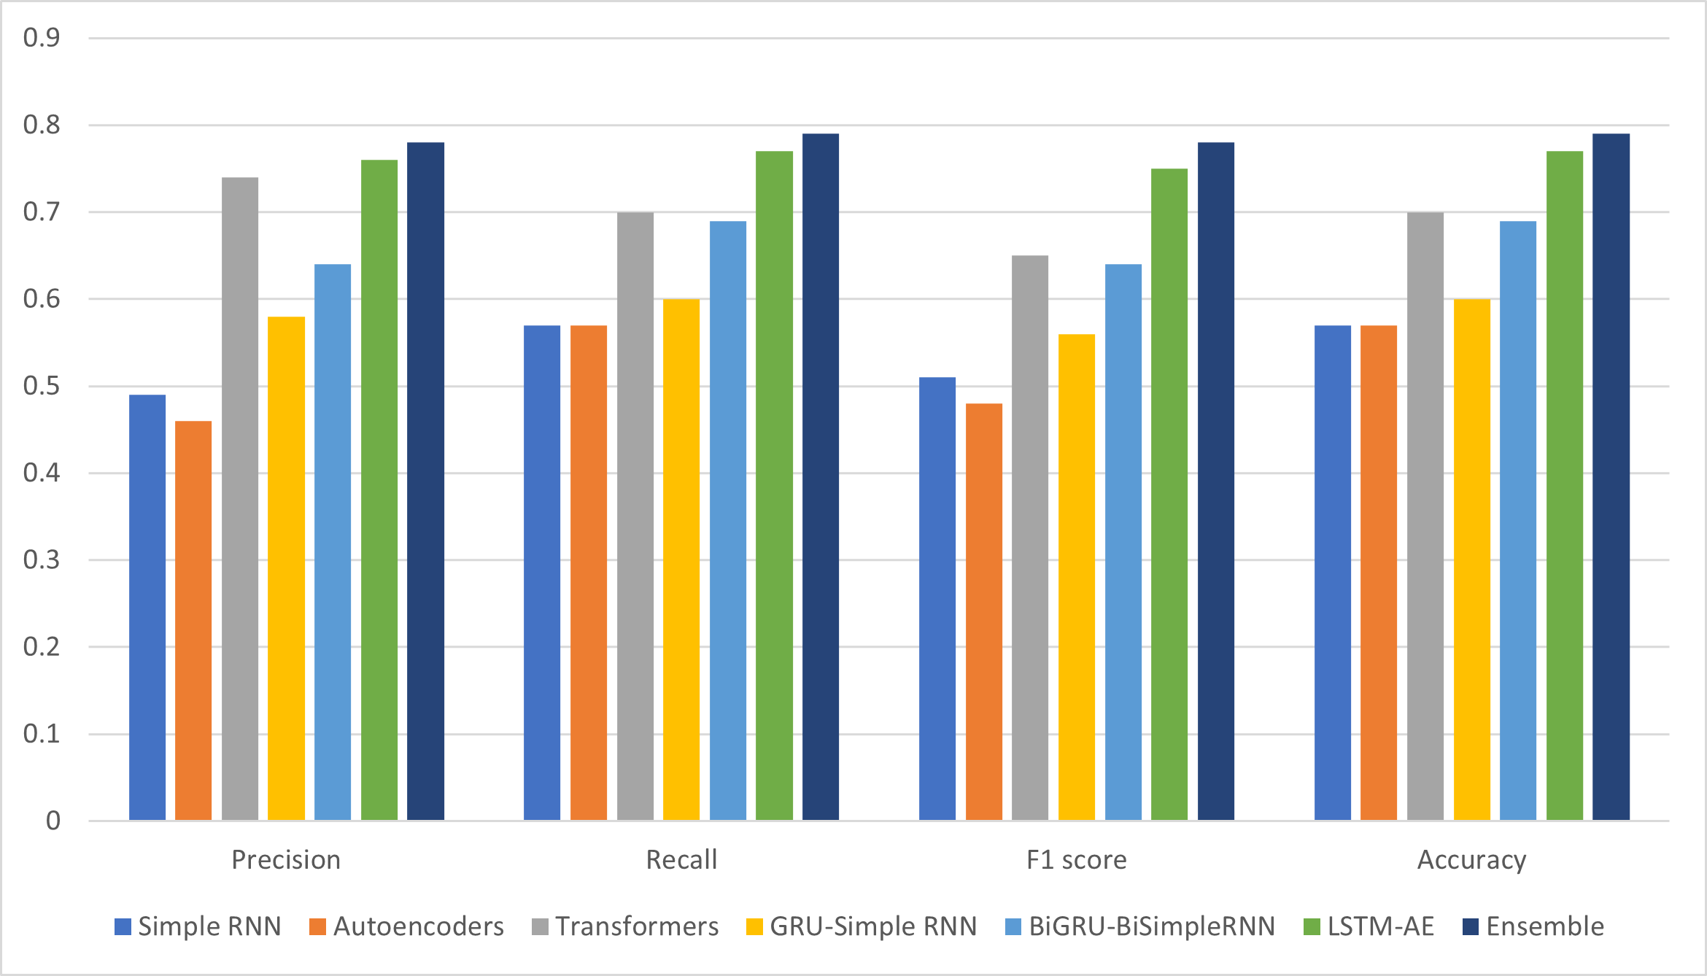
Comparison between DL Models for Univariate Data

Slide 31
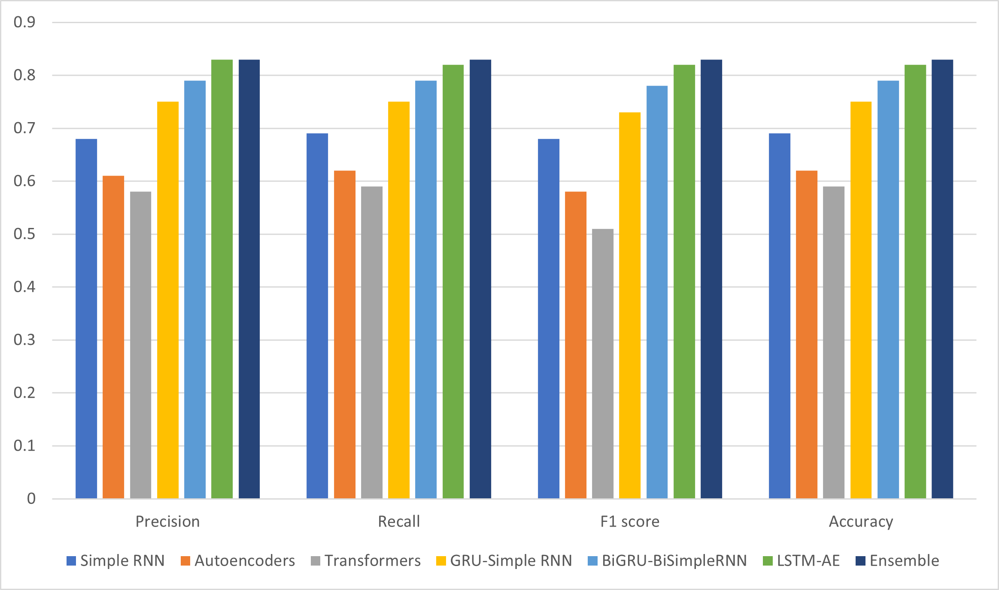
Comparison between DL Models for Multivariate Data

Slide 32
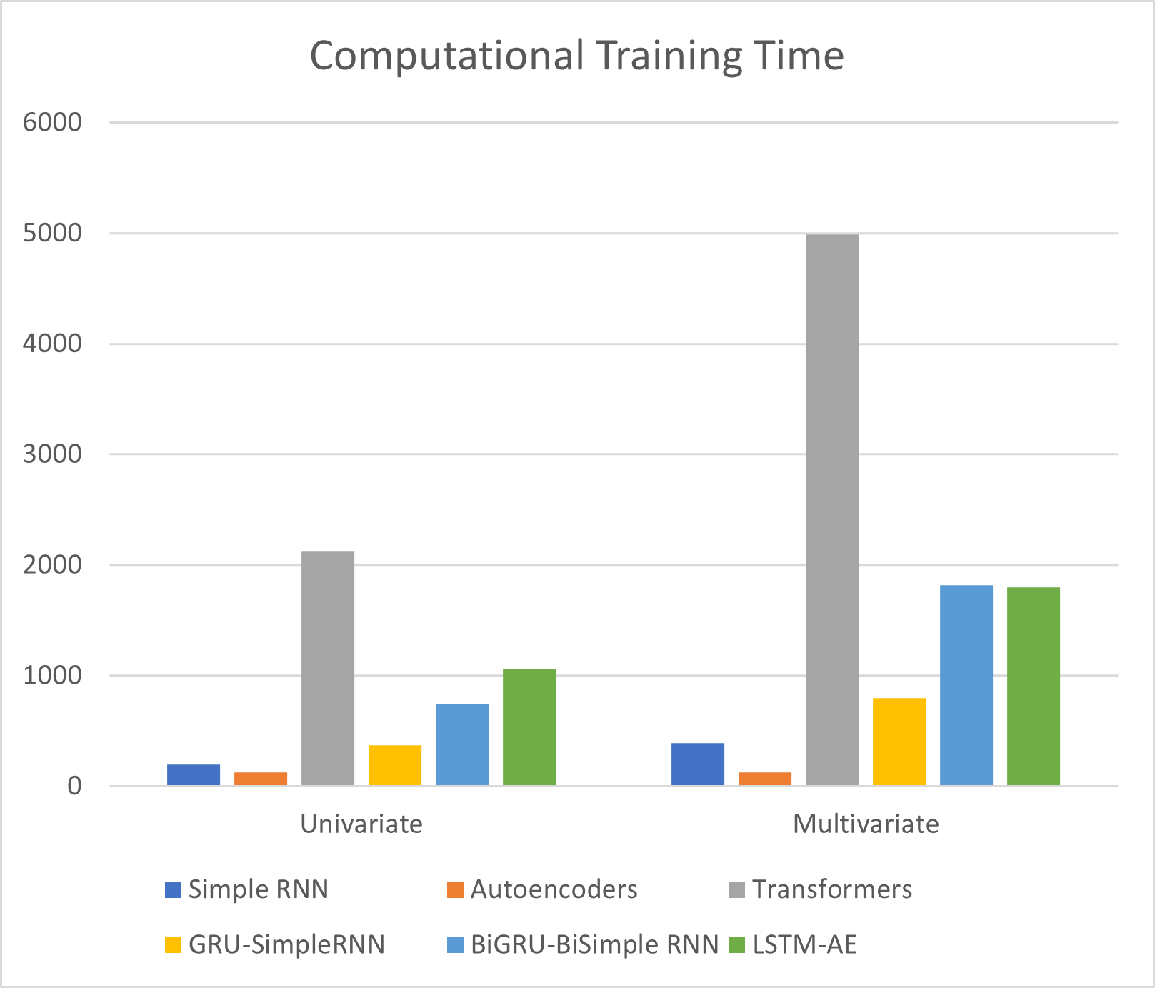
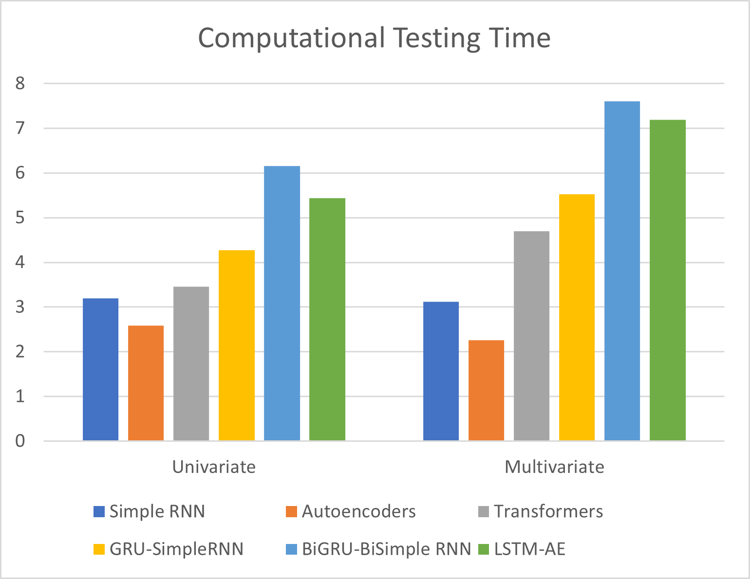
Representation of Computational Time for DL Models
(Seconds)
(Seconds)

Slide 33
CONCLUSION & FUTURE SCOPE

Slide 34
Conclusion
01
The Traffic Model of MOBATSim consisting of 10 vehicles with 3 different scenarios is adapted. Sensor Faults are injected using FI block at speed and distance sensor of Vehicle 2 and vehicle 6 .
02
Faulty and Fault-Free (univariate and multivariate) data is generated and eventually, labeled and pre-processed
03
Simple RNN, GRU-Simple RNN, Bidirectional GRU-Bidirectional Simple RNN, Autoencoders, Transformers, and LSTM-Autoencoder architectures are used for training and testing both types of data and later the stacking Ensemble Technique is also used in order to improve accuracy.
04
LSTM-Autoencoders perform the best out of all the DL models used for both types of data and Ensemble improves the accuracy by increasing from 77% to 79% with univariate data and from 82% to 83% with multivariate data.

Slide 35
Future Scope
1
2
Data Collection with different changes in the Vehicle Model for MOBATSim
Other fault types like hardware and network faults can be implemented
3
Other DL, ML, and Ensemble algorithms can be used for fault classification.
4
Different pre-processing methods can be used for other architectures

Slide 36
REFERENCES
[1] https://mobatsim.com/
[2] Deep Learning-Based Anomaly Detection in Cyber-Physical Systems: Progress and Opportunities, Yuan Luo, Ya Xiao, Long Cheng, Guojun Peng, Danfeng Daphne Yao, arXiv:2003.13213v2 [cs.CR]
[3] Saraoglu, M., Morozov, A., & Janschek, K. (2019). MOBATSim: MOdel-Based Autonomous Traffic Simulation Framework for Fault-Error-Failure Chain Analysis. IFAC-PapersOnLine, 52(8), 239–244. Elsevier BV. Retrieved from https://doi.org/10.1016%2Fj.ifacol.2019.08.077[4] Monostori L. (2018) Cyber-Physical Systems. In: The International Academy for Production, Chatti S., Tolio T. (eds) CIRP Encyclopedia of Production Engineering. Springer, Berlin, Heidelberg. https://doi.org/10.1007/978-3-642-35950-7_16790-1
[5] A. Nanduri and L. Sherry, "Anomaly detection in aircraft data using Recurrent Neural Networks (RNN)," 2016 Integrated Communications Navigation and Surveillance (ICNS), 2016, pp. 5C2-1-5C2-8, doi: 10.1109/ICNSURV.2016.7486356.
[6] https://medium.com/@felixs_76053/bidirectional-gru-for-text-classification-by-relevance-to-sdg-3-indicators-2e5fd99cc341
[7] “LSTM-Autoencoder based Anomaly Detection for Indoor Air Quality Time Series Data”, Yuanyuan Wei, Julian Jang-Jaccard, Wen Xu, Fariza Sabrina, Seyit Camtepe, Mikael Boulic, arXiv:2204.06701v1 [cs.LG]
[8] “TranAD: Deep Transformer Networks for Anomaly Detection in Multivariate Time Series Data” , Shreshth Tuli, Giuliano Casale, Nicholas R. Jennings, arXiv:2201.07284v6 [cs.LG]
[9] https://towardsdatascience.com/anomaly-detection-using-autoencoders-5b032178a1ea
[10] https://machinelearningmastery.com/stacking-ensemble-for-deep-learning-neural-networks/
[11] https://de.mathworks.com/matlabcentral/fileexchange/75539-fault-injection-block-fiblock

Slide 37
THANK YOU

